Slide 1
Nanofabrication by nano-imprint and electron beam lithography and applications
Bo Cui (崔波)，Professor
Department of Electrical and Computer Engineering
bcui@uwaterloo.ca
https://ece.uwaterloo.ca/~bcui/
Zhejiang University, December 13, 2017

Slide 2
Notes:
Engineering fast facts

Slide 3
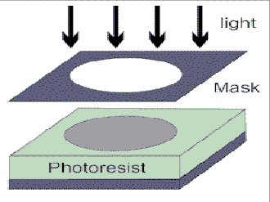
Lithographies: a comparison
Photolithography: duplicate pattern on the photo-mask into photo-resist
fast, low resolution (~λ), standard for micro-fabrication
Electron beam lithography (EBL): generate pattern by serial writing into a resist slow (1 wafer/day), high resolution (~10nm)
Focused ion beam lithography: similar to e-beam lithography but more versatile, high resolution, slower.
Nanoimprint lithography (NIL): duplicate mold pattern into a polymer resist
fast, high resolution (2nm), low cost
NIL is the choice for nanoscale patterning over large surface area, good for volume production.
EBL is ideal for R&D, over small surface area.
Photo-lithography

Slide 4
Outline
Overview of nanofabrication process
Electron beam lithography using polystyrene and PMMA monolayer brush resist
Nanoimprint lithography using polymer mold
Nano-structured surface plasmon resonance (SPR) bio-sensor
Nano-prism and bow-tie structure for chemical sensor based on surface enhanced Raman scattering (SERS)
Bio-sensor based on extraordinary optical transmission (EOT) through periodic hole array in Au

Slide 5
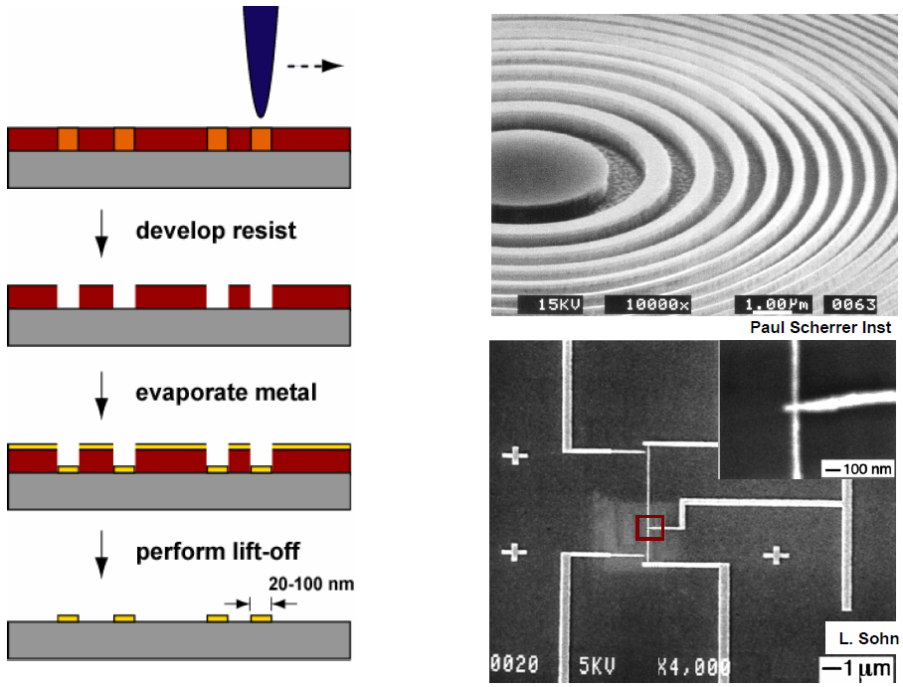
Electron beam lithography (EBL)
Finely focused electron beam, φ=2-5nm
Resist
(PMMA…)
Metal patterning by EBL and liftoff

Slide 6
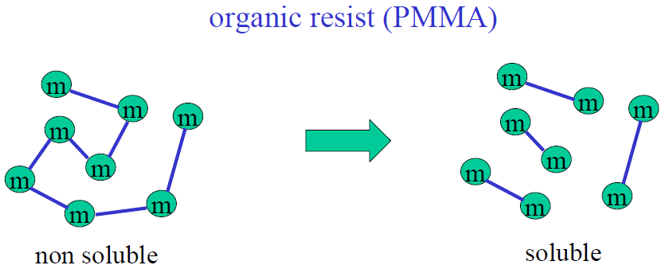
Electron beam lithography: resist
PMMA (Poly(methyl methacrylate)) is the “standard” resist.
Positive tone, simple, cheap.
High resolution (sub-20nm).
Low sensitivity (~300µC/cm²), slow writing.

Slide 7
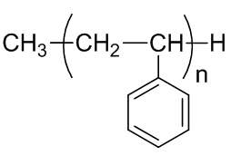
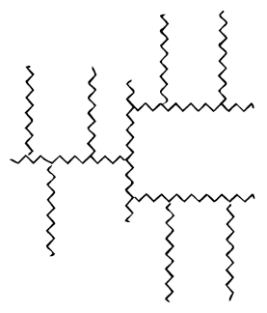
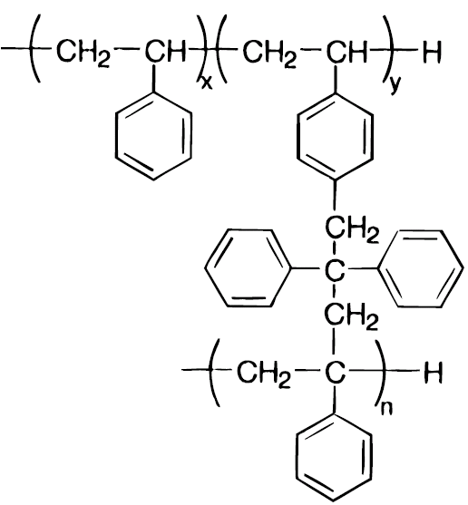
E-beam exposure of polystyrene (negative)
Linear polystyrene
Cross-linked by e-beam exposure, schematic and chemical structure
Linear polystyrene (PS) can be dissolved by many common solvents: acetone, tetrahydrofuran, chlorobenzene, cyclo-hexane, xylene, anisole, and so on.
Cross-linked PS is insoluble in those solvents.
Thus ALL those solvents can be used as developer for PS.

Slide 8
Motivation: why polystyrene?
Polystyrene (PS) is a negative resist, and it offers:
Very high resolution for low molecular weight PS.
Very high sensitivity for high molecular weight PS.
Simplicity, a simple polymer like PMMA, thus low cost and unlimited shelf life.
Easy development – any solvents that dissolves unexposed PS can be used, with similar performance.
High dry etching resistance for etching mask, similar to ZEP.
Moreover, it can be:
Coated on any surface (flat or not) by thermal evaporation.
Dry thermally developed on a hotplate, in order to avoid pattern collapse and peel off due to capillary force for solvent development.
→Polystyrene is a very versatile negative resist.

Slide 9
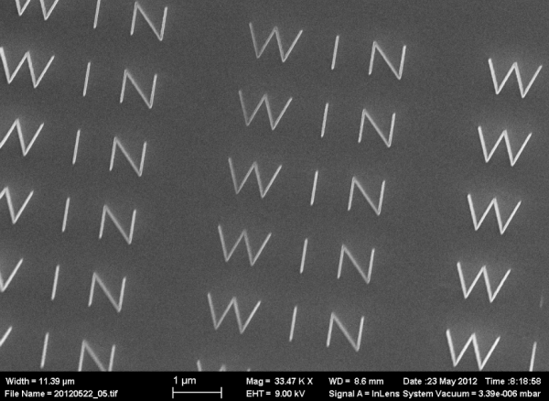
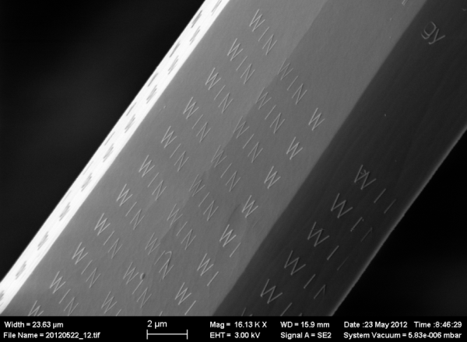
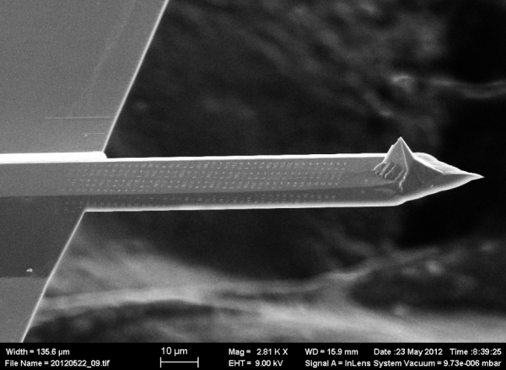
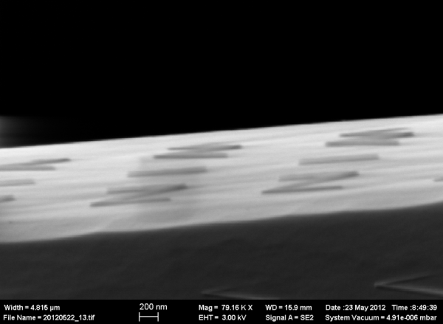
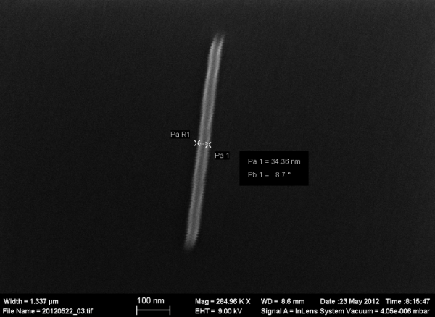
Polystyrene can also be thermally evaporated
Spin-coating only works for flat surface such as a wafer.
Evaporated resist can be coated on any surface, such as on an AFM tip or optical fiber.
However, most resists (e.g. PMMA) decomposes at temperature needed for evaporation.
Nevertheless, we are able to thermally evaporate low molecular weight polystyrene.
Electron beam lithography on an AFM cantilever using evaporated polystyrene resist.
“WIN” = Waterloo
Institute for Nanotechnology
Top view
Tilt view
Side view
Zoom-in, line-width 34nm
Cantilever written with WIN
Zhang and Cui, ACS Nano 2014,
9
Notes:
Here we worked on to differenetiate the polystyrene deposition between thermally evaporated and spin-coated and found spin-coated PS is more sensitive than evaporated PS film. However, sometimes evaporated PS is needed for depositing on non-flat surface.

Slide 10
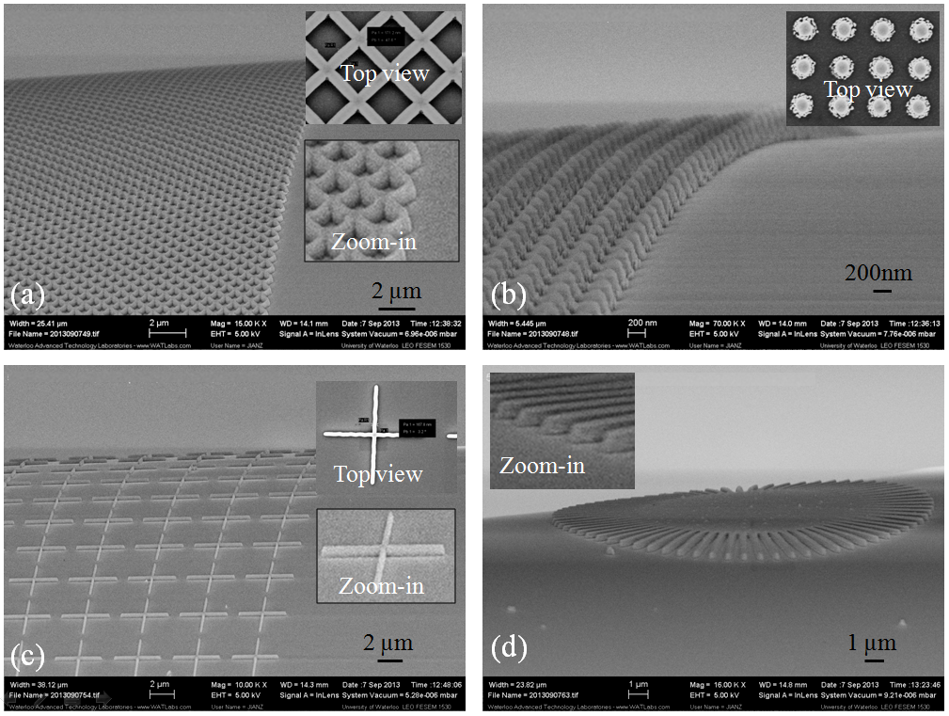
Nanofabrication on optical fiber using evaporated polystyrene resist
Zhang and Cui, ACS Nano 2014
Notes:
One important application is patterning on fiber. This is very useful for devices such as Bragg grating, optical filter, sensors and plasmonic lens. Different patterns were exposed as shown in the slide. Patterns can be transferred to sublayers such as Al and the fiber. And Fig.d shows the uniformity of scanning direction.

Slide 11
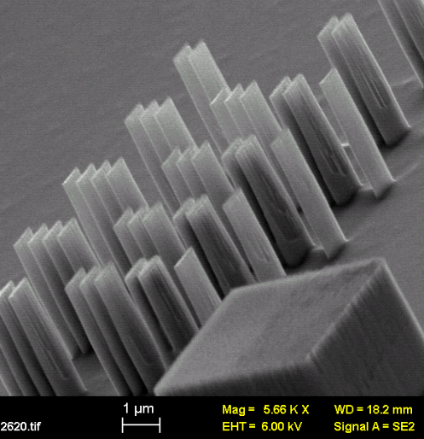
Nano-composite resist Cr/polystyrene by co-evaporation
Polymer resist is not good mask for pattern transfer to the substrate, with typical etching selectivity to silicon on the order of 1:1.
Metal is ideal etch mask, with selectivity on the order of 1:100 (that is, etches silicon 100× faster than metal).
Nano-composite resist Cr/PS can be patterned directly by electron beam lithography, with very high resistance to etching as it contains metal.
This can be realized for polystyrene since it can be evaporated, like most metals (Cr, Al…).
PS/Cr
silicon
Silicon structures with 100nm width and 3µm height. (if using pure polystyrene resist, can etch at most 400nm height)
ICP-RIE (reactive ion etching) using SF₆ and C₄H₈ gas. Resist consists of 7% Cr.
Con and Cui, Nanotechnology, 2014

Slide 12
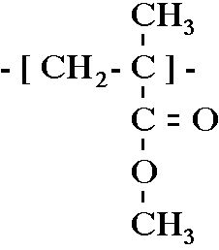
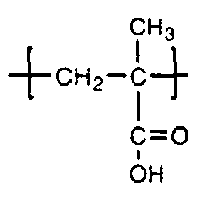
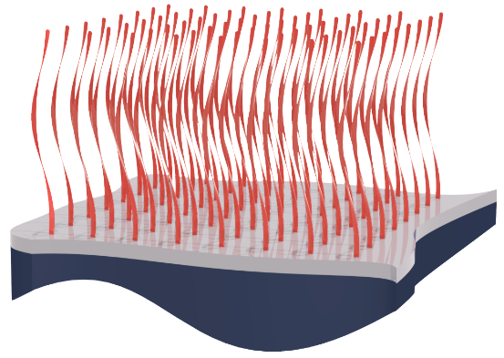
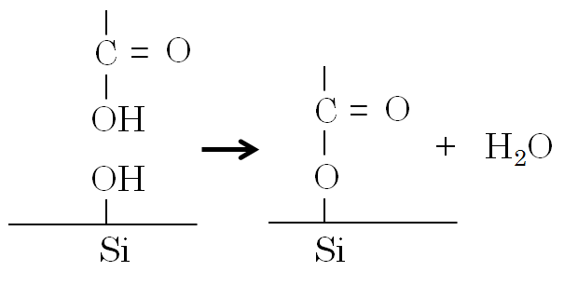
E-beam lithography using PMMA monolayer brush resist
The PMMA contains 1.6% MAA ((meth)acrylic acid), to further promote the grafting process as MAA contains the desirable –COOH group.
The -COOH group chemically bonds with -OH group.
PMMA-CO-PMAA
[
]
[
-co-
The monolayer brush is too thin for pattern transfer.
Thus we need an intermediate hard-mask (here Al) for etching into the substrate.
PMMA
Monolayer brush
Al
Anneal
and acetic acid wash
Any surface
EBL
Al
RIE
Al wet etch
Dey and Cui, Advanced Materials - Interfaces, 2016

Slide 13
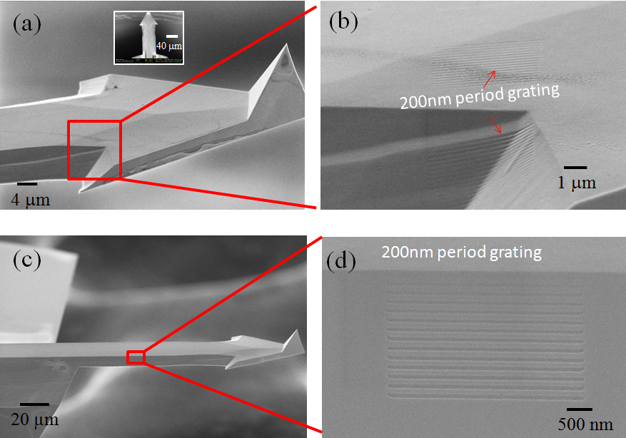
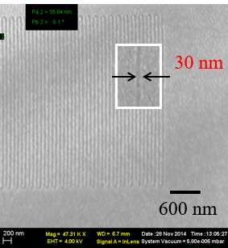
High resolution grating etched into AFM cantilever (silicon)
Dey and Cui, Advanced Materials - Interfaces, 2016

Slide 14
Outline
Overview of nanofabrication process
Electron beam lithography using polystyrene and PMMA monolayer brush resist
Nanoimprint lithography using polymer mold
Nano-structured surface plasmon resonance (SPR) bio-sensor
Nano-prism and bow-tie structure for chemical sensor based on surface enhanced Raman scattering (SERS)
Bio-sensor based on extraordinary optical transmission (EOT) through periodic hole array in Au

Slide 15
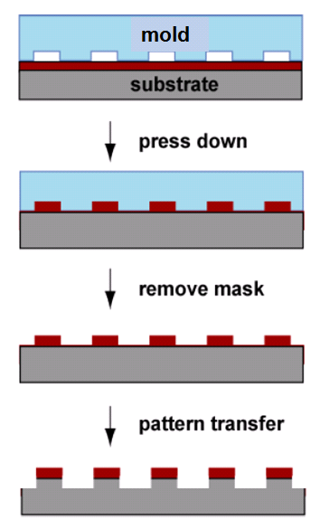
Nanoimprint lithography (thermal/hot embossing)
Thermoplastic or thermal-set polymer resist
(PMMA, polystyrene…)
Heat-up polymer resist and press down
Why nanoimprint lithography?
Photolithography: high throughput, low cost, low resolution.
Electron beam lithography: high resolution, low throughput, high cost.
Focused ion beam lithography: high resolution, most versatile (can remove material by milling), yet lower throughput and higher cost than electron beam lithography.
Nanoimprint lithography: high resolution, high throughput, low cost.
Cool-down and remove mold
Pattern transfer to substrate (optional)

Slide 16
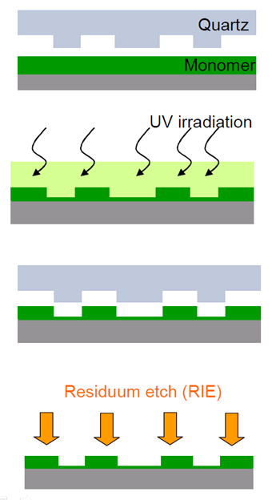
UV-curing nanoimprint lithography
UV-resist: monomer, photo-initiator, additives (surfactant, coupling agent…).
Liquid resist, soft and deformable by mold.
Hardened by UV-curing (polymerization).
Molds must be transparent to UV.
Room temperature, no thermal cycle.
Thus thermal expansion mismatch is no longer an issue – precise alignment possible.

Slide 17
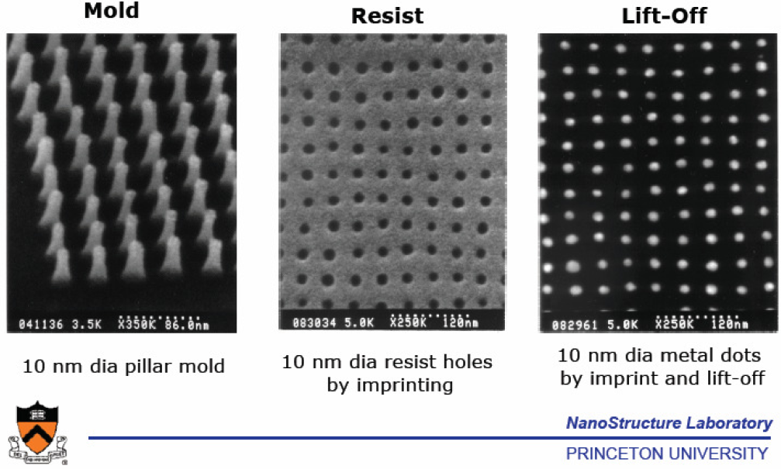
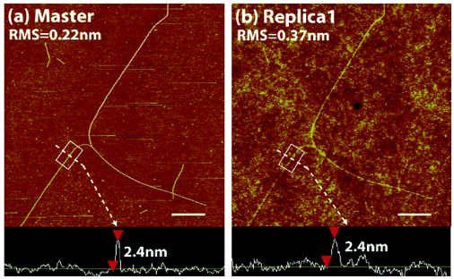
Key advantage of NIL: highest resolution
UV-curable NIL
2nm carbon nanotube “mold”

Slide 18
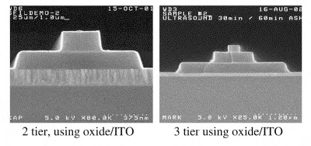
Another key advantage: 3D imprinting
3D mold
Could be used for IC interconnection:
Patterning of the via and interconnect layers simultaneously.
Thus potentially reduces the number of masking levels.

Slide 19
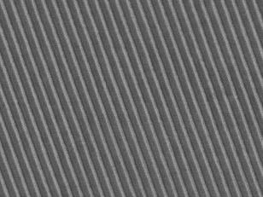
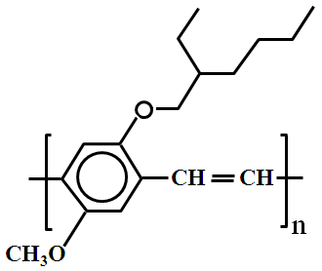
Functional “resist”: semiconducting polymer
200nm period MEH-PPV grating R-P3HT grating with 200nm period
1 μm
Metal electrode
N
P
ITO
Transparent substrate
Nanostructured junction, high junction area, high solar cell efficiency.

Slide 20
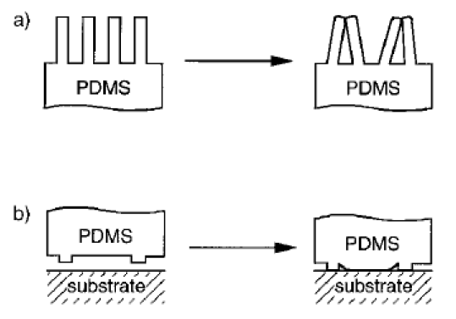
Soft lithography
Soft lithography (PDMS):
Low or no applied pressure.
No need of vacuum.
Conformal contact even for non-flat or curved surface.
But low resolution because PDMS is too soft.
→The solution is hard film (here UV-cross-linked resist) on soft PDMS.

Slide 21
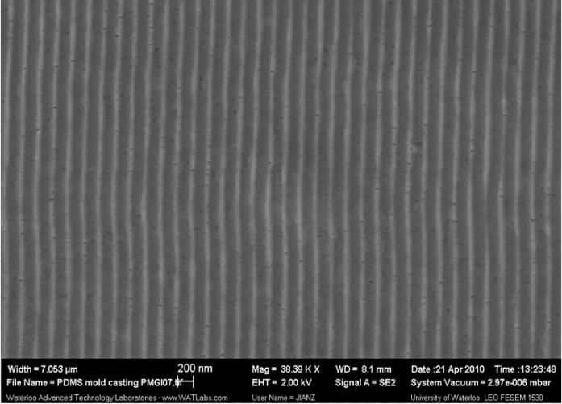
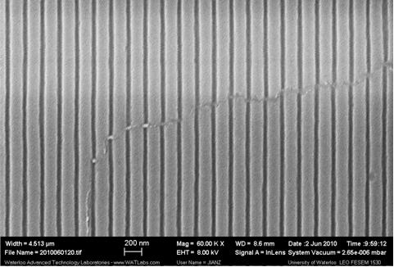
Hybrid nanoimprint-soft lithography
Si master mold
PMGI
Duplicated sacrificial mold in PMGI
(PMGI: Polydimethylglutarimide)
UV-resist absorbed PDMS
PDMS (soft)
UV-resist (hard)
Si wafer
Dissolve PMGI
200nm period grating
Hybrid mold in UV-cured resist/PDMS Imprint result into UV-curable resist

Slide 22
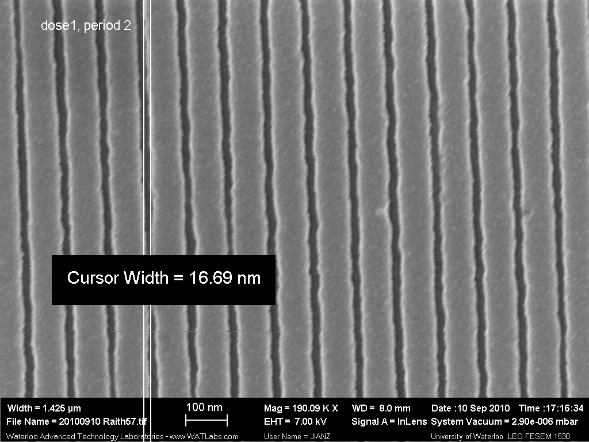
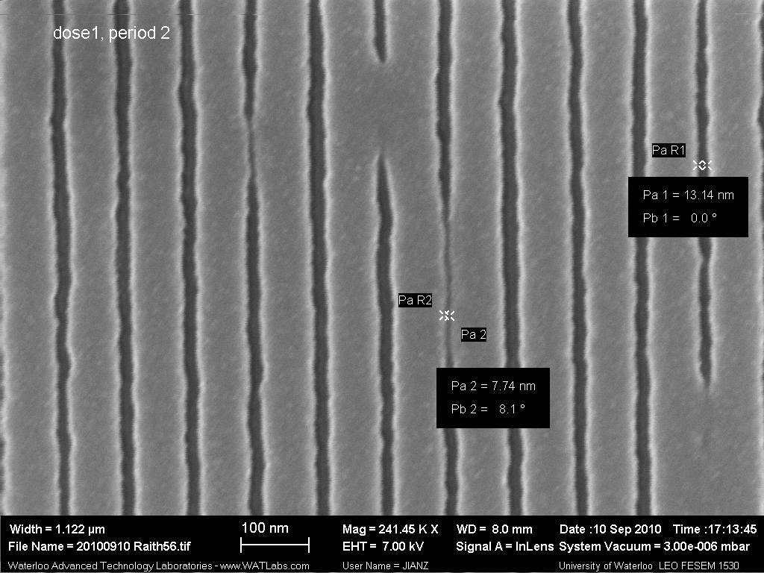
Hybrid nanoimprint-soft lithography
Here mold is fabricated by electron beam lithography in PMGI
Grating pattern with 17nm–trench width. The grating period is 100 nm.
The narrow gap of only ~8 nm-wide in PMGI was faithfully duplicated into the UV-resist.
The resolution of the current process is below 10 nm, without the need of applied pressure, vacuum, or high temperature.
Zhang and Cui, Microelectronic Engineering, 2011.

Slide 23
Outline
Overview of nanofabrication process
Electron beam lithography using polystyrene and PMMA monolayer brush resist
Nanoimprint lithography using polymer mold
Nano-structured surface plasmon resonance (SPR) bio-sensor
Nano-prism and bow-tie structure for chemical sensor based on surface enhanced Raman scattering (SERS)
Bio-sensor based on extraordinary optical transmission (EOT) through periodic hole array in Au

Slide 24
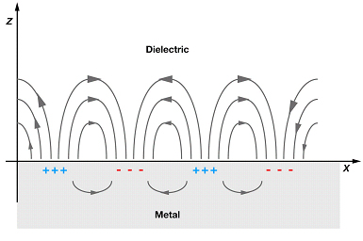
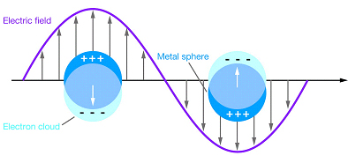
Plasmon: “bulk”, surface, localized
Plasmon: collective oscillation of free electrons
(very different from plasma TV (ionized gas))
Surface plasmon: plasmon confined to surface
-σ₀
+σ₀
t=0
E_{ext}
t=T/2=π/ω (half period)
Localized surface plasmon: plasmon confined to (metal) nano-structures
E_{ext}
Metal nano-sphere
~ frequency of
visible light

Slide 25
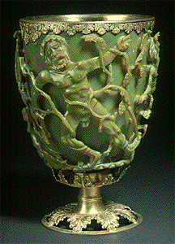
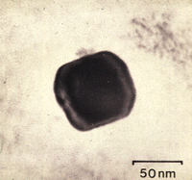
Lycurgus Cup of the 4th Century
Green = Reflected light
Red = Transmitted light
Image of Ag/Au
nanoparticle in the
Lycurgus cup
Color is due to resonant absorption of light, which excites localized surface plasmon when frequency f(light)≈f(plasmon)

Slide 26
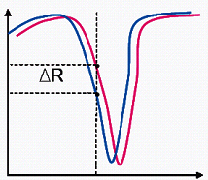
Surface plasmon resonance (SPR) biosensor
Plasmon: collective oscillation of free electrons
SPR: excitation of surface plasmon by light
Plasmon frequency is very sensitive to changes on metal surface
Application: biosensor (DNA, protein…)
target bio-molecule
absorption of target molecule
Gold
50nm
glass
θ
prism
Reflectivity
Light in
(λ=800nm)
Reflected light
Angle of incidence
- Excitation of surface plasmon by evanescent wave
- Resonant absorption occurs at certain angle θ

Slide 27
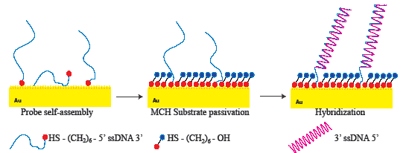
Enhanced DNA hybridization detection by SPR on periodic Au nano-post array
Au nano-post
Au nano-posts increase sensitivity by:
Increasing the surface area for DNA binding.
Coupling between localized (from nano-posts) and propagating (from underlying continuous film) surface plasmon.
Au film
ssDNA
(ss: single strand)
dsDNA
(ds: double strand)
Au
DNA hybridization leads to a change in -
- refractive index by 5%
- thickness by 3.5nm

Slide 28
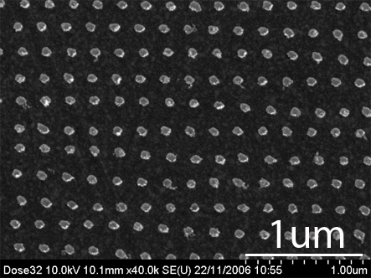
Enhanced SPR detection of DNA hybridization
Post diameter (fixed period 110nm, height 30nm )
buffer
Reflectivity (%)
250nM DNA target
SEM image of Au nano-post array on 20nm flat Au film
Time (min)
ssDNA
hybridization
dsDNA
Sensitivity was enhanced by 5× when post diameter = 50nm
Optics Letters, 2007

Slide 29
Outline
Overview of nanofabrication process
Electron beam lithography using polystyrene and PMMA monolayer brush resist
Nanoimprint lithography using polymer mold
Nano-structured surface plasmon resonance (SPR) bio-sensor
Nano-prism and bow-tie structure for chemical sensor based on surface enhanced Raman scattering (SERS)
Bio-sensor based on extraordinary optical transmission (EOT) through periodic hole array in Au

Slide 30
SERS (surface enhanced Raman spectroscopy)
SERS effect: enormous enhancement (up to 10¹²) of Raman scattering when a molecule is adsorbed on nanostructured metallic surface.
This arises from two main mechanisms
Electromagnetic effect (dominant):
localized surface plasmon resonance. (Raman intensity ∝ E⁴ )
Chemical effect: electronic coupling between molecule and metal.
metal nanostructure
E>>E_{ext}
Advantage of SERS: (3 “S”)
Sensitivity - high, single molecule detection demonstrated
Selectivity - high, fingerprint of each type of molecule
Speed - high, few seconds
High field at tiny gaps
High field at sharp corners, or tiny gaps if close enough
Metallic particles
(chemical synthesis)
Metal nanostructure
Nanofabricated metal structures - tunable resonant wavelength, homogeneous size/shape, more reproducible and reliable SERS detection

Slide 31
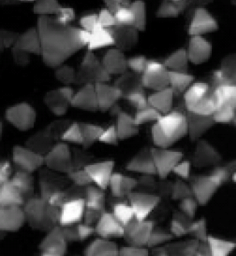
One example: nano-prism
(triangular nanostructure)
Sharp corners of the nanoprism lead to a strong local electromagnetic field enhancement.
Horizontal polarization
Vertical polarization
Low electrical field
nanoprism
High field spots
Previous fabrication method:
Chemical approach: reduction of metal salts (difficult).
Light-induced aggregation of small nanoparticle seeds
(low yield and none-homogeneous)
Jin, Science, 294, 1901(2001)

Slide 32
Fabrication principle
Direction of angle evaporation of Ti
PMMA pyramid by NIL with a mold having inverse-pyramid-shaped hole
PMMA pyramid
Si wafer
1. NIL into PMMA
3. RIE etch PMMA
Ti
Cr/Ag prism
2. Evaporate Ti at large angle
4. Evaporate and liftoff metal

Slide 33
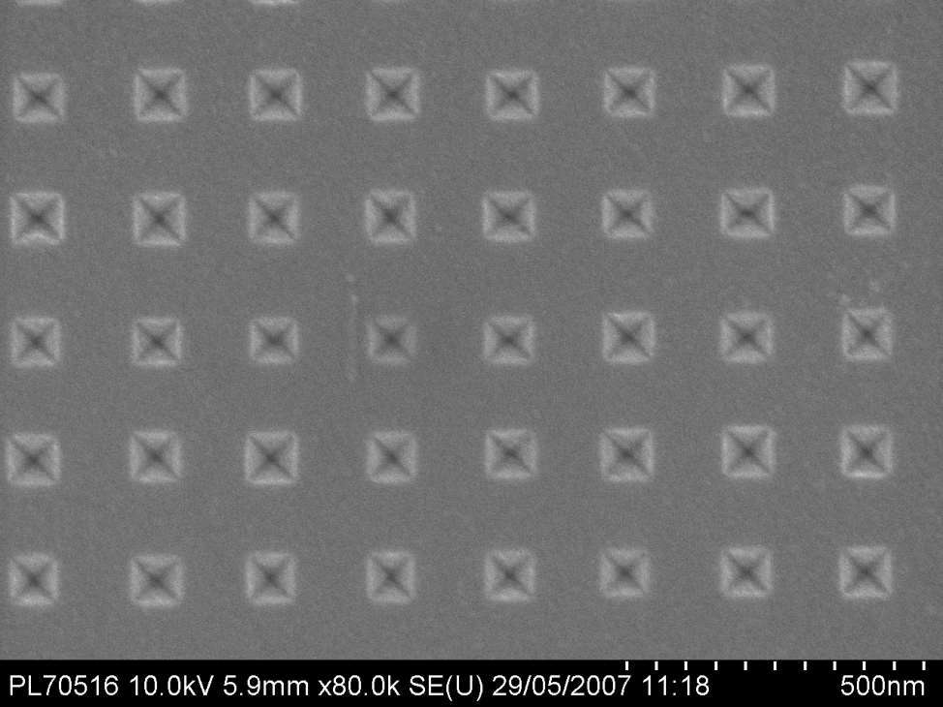
Fabrication of mold with inverse-pyramid-shaped hole array
(111)
SiO₂ mask
Si (100)
KOH etch Si (111) direction 100 times slower than other crystalline planes. So etching will “stop” at (111) crystalline plane, forming an inverse-pyramid-shaped hole.
SEM image of the mold
(SEM: scanning electron microscopy)

Slide 34
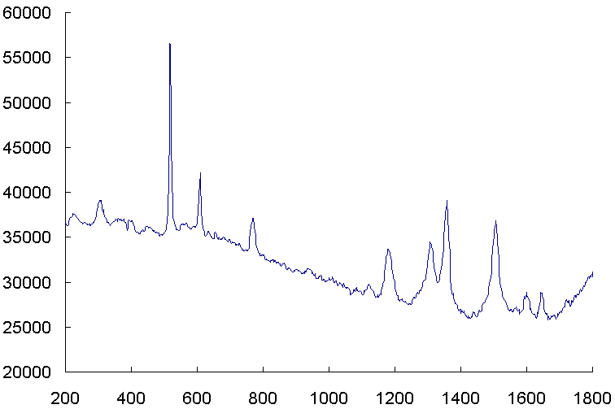
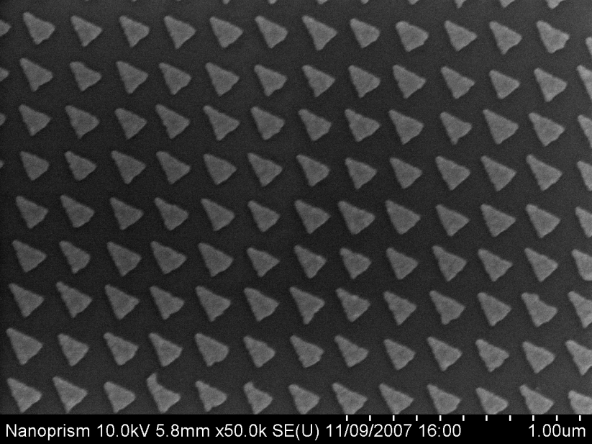
SERS detection of rhodamine 6G (R6G) molecule
SEM image of 200nm period nanoprism
Si
nanoprism array of Cr(2.5nm)/Ag(20nm)
Raman Intensity (arb. units)
Raman Shift (cm⁻¹)
Raman measurement:
excitation laser λ=785nm, power 0.16mW/mm², beam spot size 25-30μm, collection time 3sec.
Raman signal from ~monolayer R6G is nearly comparable to that from bulk silicon
Cui, et at. Nanotechnology, 2008

Slide 35
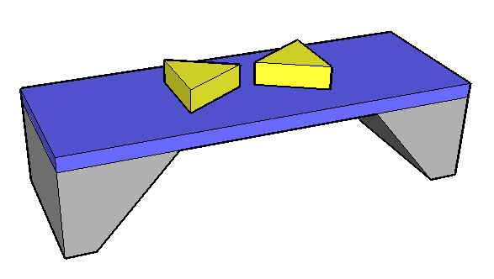
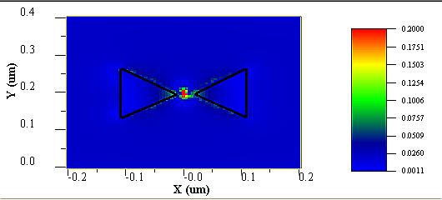
SERS using bow-tie (two nano-prisms facing each other) structure
Bow-tie structure offers “hot-spot” (very high EM field) at the gap, ideal for SERS.
It is difficult to fabricate bow-tie with sub-10nm gap due to electron backscattering in electron beam lithography.
Here we fabricated bow-tie on a thin (100nm thick) membrane to eliminate electron backscattering.

Slide 36
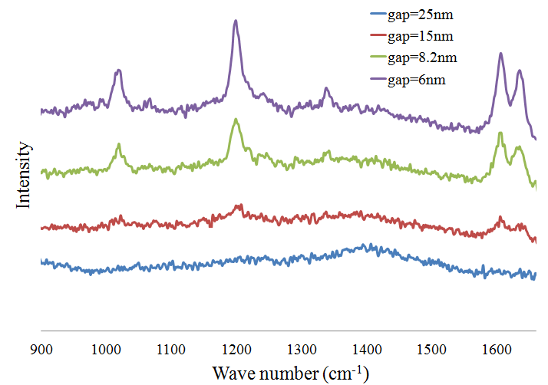
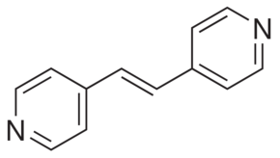
SERS using bow-tie structure
BPE
(trans-1,2-bis(4-pyridyl)ethylene)
Raman spectrum of BPE on gold bow-tie nano-structures with gap 6nm, 8.2nm, 15nm, 25nm, respectively.
Notes:
The hotspots locates in the gap. So the gap impact the signal greatly. The next slide shows different hotspots location. Not on the gap.

Slide 37
Effects of concentration of target molecule (BPE)
EF=10⁷
EF=10⁵
EF: enhancement factor
Notes:
The gap size will effect the sensitivity of bowtie antenna greatly. Here, we compared the bowtie with 6 nm gap and 25 nm gap. We can see 6 nm-gap bowtie can achieve at the lowest concentration at 10-6 mM, while the 25 nm gap one can only achieve at 10-3 mM. gold bowtie nano-antenna with 6 nm shows higher sensitivity here.

Slide 38
Outline
Overview of nanofabrication process
Electron beam lithography using polystyrene and PMMA monolayer brush resist
Nanoimprint lithography using polymer mold
Nano-structured surface plasmon resonance (SPR) bio-sensor
Nano-prism and bow-tie structure for chemical sensor based on surface enhanced Raman scattering (SERS)
Bio-sensor based on extraordinary optical transmission (EOT) through periodic hole array in Au

Slide 39
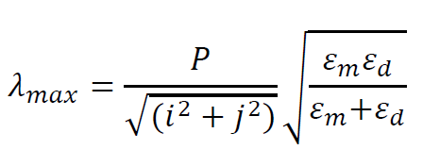
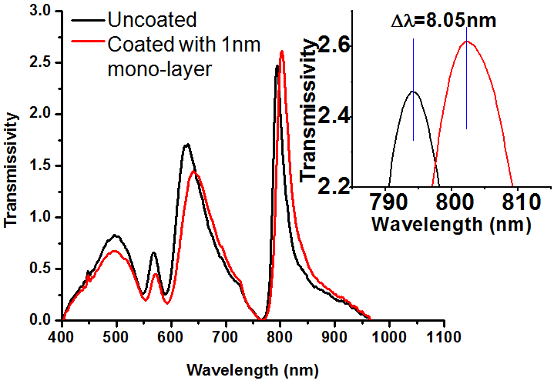
Extraordinary Optical Transmission
Extraordinary optical transmission:
Nanoscale hole array in optically thick metal films transmit light one order of magnitude more than expected.
This enhancement is due to optical coupling by surface plasmon between the two sides of the perforated metal films.
Resonant transmission peak λ_{max} is very sensitive to the change on metal surface, thus can be used as bio-sensor to detect bio-binding event.
Resonant transmission with maximum intensity when λ=λ_{max}.
i, j=0, 1, …; P: array period
ε_{m}, ε_{d}: dielectric constant for metal and the medium above (ε_{d} =1 in air).
Hole array in Au film
(1,1)
(1,0)
T. W. Ebbesen et al, Nature, 1998
Notes:
transmission mode operation at normal incidence makes low cost portable tools possible;
the footprint of EOT device, i.e. the area covered by the hole array, can be as small as ~5 μm, over one order smaller than that for prism-coupled SPR sensor (~200 μm), enabling detection of thousands of targets in the same chip without sacrifice of sensitivity;
the intrinsic sensitivity, in term of resonant wavelength shift/mass of attached biomaterial over device area (nm/pg), is 2-3 orders higher, again due to its much smaller device area, thus making trace amount detection possible;
the non-contact optical measurement obviates the need for a prism and index-matching fluids, and greatly facilitates high-resolution imaging for highly parallel arrayed measurement.

Slide 40
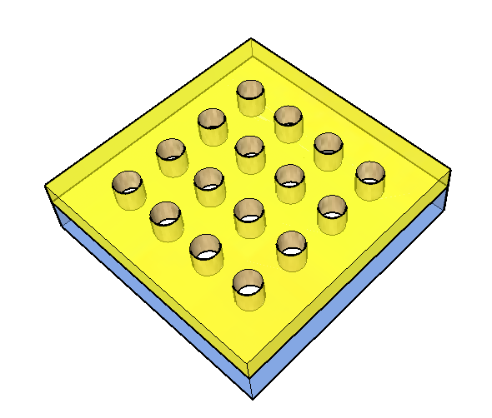
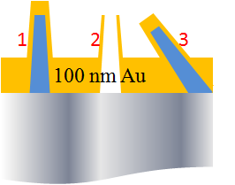
Fabrication of Au hole array by double liftoff process
E-beam lithography
10nm Cr
100nm ZEP-520A
20nm SiO2
200nm PMGI
Silica
(a) Single liftoff process
(b) Double liftoff process
3.
2.
1.
500 nm
500 nm
Notes:
(1) Normally, the exposed resist pillars are tapered, so the sidewall of the pillars is easily covered with metal by lateral deposition, which will prevent the dissolution of resist during liftoff.
(2) For the same reason as above, the metal on sidewall is remained after lift-off. Thus chimney-shape structures are formed instead of flat hole array.
(3) For ideal liftoff process, the thickness of resist is required to be more than three times of the deposited metal. But pillars with high aspect ratio collapse frequently during development because of capillary force..

Slide 41
Effect of hole diameter and array period on transmission
Diameter=153.5 nm, 174.9 nm, 184.2 nm, 198.2 nm, 209.3 nm, 234.5 nm.
Period=400 nm, 425 nm, 450 nm, 475 nm, 500 nm, 525 nm, 550 nm.
Larger period, (proportionally) longer resonant wavelength.
Larger diameter, (slightly) longer resonant wavelength.
Notes:
Based by double liftoff method, nanohole array with varied diameters and periods were fabricated. Here, we show the transmission measurements. With the increasing period, the peak shows red shift, which matches the expressed function.

Slide 42
Effect of Au surface roughness and methods for its reduction
Rough polycrystalline Au film
Methods for smooth Au:
Template stripping, only one side smooth.
Optimize the adhesion/seed layer below Au (Cr, Ge, -SH), best for thin Au film (<30 nm thick).
Adhesive
Au
(1)
Peel off and flip over
(2)
RMS roughness=6.4
RMS roughness=7.0
RMS roughness=7.5
Notes:
For the second issue, the gold film quality also needs to be considered. The film quality will effect the transmission in two aspects:
(1) The rough surface causes random reflection of part of the incident light that reduces the transmission intensity;
(2) The boundaries and grains within the polycrystalline film increase the scattering and absorption, reducing the transmission intensity.
There are several ways reported to improve the film quality:…

Slide 43
Smoother Au film by thermal annealing
Annealing condition: 600ºC for 1hour in Ar.
Effects of annealing: reduce roughness by 2×, shrink hole diameter by ~15%
D=175 nm
D=235 nm
RMS=1.87 nm
D=175 nm
D=236 nm
D=149 nm
D=208 nm
RMS=0.89 nm
D=149 nm
D=208 nm
Notes:
In our work, annealing method was carried out in tube furnace at 600 degree for 1 hour with the protection of Ar. We can see that annealing method will effect the gold film in two aspects:
First, the RMS roughness was reduced by 72% from 6.4 nm to 1.8 nm. Second, the hole size is reduced from 175 nm to 150 nm, and 235 nm to 208 nm, respectively.

Slide 44
Effect of smoother Au on optical transmission
Diameter=150 nm
Diameter=209 nm
Effects of annealing on optical transmission:
Peak blue-shift
Higher peak intensity
Agree better with numerical simulation
Notes:
We compared the annealed result and non-annealed result. The back and red curves show the changes before and after annealing on the same sample. The blueshift is caused by the shrinkage of hole size. And with narrower hole, the intensity is increased abnormally, which is because of the improvement from annealing.
On the other hand, annealed and non-annealed sample were compared with the closet diameter, shown in the black and blue curve. The intensity is enhanced obviously, which is because of the improvement of gold film quality. There is less absorption and scattering during transmission in gold film.
The green curve is the simulated result. It shows that the annealed result matches the theoretical one better.

Slide 45
EOT sensing of a self-assembled mono-layer film MHA (~1 nm thick)
16-Mercaptohexadecanoic acid (MHA), refractive index n=1.48
D=153.5 nm
D=209.3 nm
Non-annealed
(low sensitivity)
D=148.8 nm
D=208.4 nm
Sensitivity=41 nm/RIU
Annealed
(high sensitivity)
Notes:
For EOT sensor, most of the current reported sensitivity is ~5 nm/RIU. Here, we compared the annealed and non-annealed sample by a self-assemble monollayr of 16-MHA, and found the peak shift is much greater in annealed sample. As the result, we achieved the highest sensitivity at 41 nm/RIU.

Slide 46
Summary
Electron beam lithography: versatile negative resist polystyrene and positive PMMA monolayer brush:
Its property can be tuned easily by using different molecular weight Mw.
Low Mw PS can be thermally evaporated, thus capable of nanofabrication on irregular non-planar surfaces.
Grafted monolayer PMMA brush can also be utilized to pattern irregular surfaces.
Nanoimprint lithography using polymer mold:
Developed hybrid nanoimprint soft lithography using a mold with rigid polymer on top of flexible PDMS, which achieved 8nm resolution without applied pressure, vacuum or high temperature.
Biosensor based on surface plasmon resonance: increased sensitivity for DNA hybridization detection by 5×, through nano-structuring the Au substrate.
Chemical sensor based on SERS: fabricated and studied nano-prism and bow-tie structure with gap down to 3 nm.
Biosensor based on extraordinary optical transmission: Au hole array fabricated, thermal annealing improves sensitivity.

Slide 47
Commercialization project
Fabrication of hollow micro-needles (in collaboration with ExVivo Inc, Waterloo)
Fabrication of AFM probes (杭州探真纳米科技有限公司)

Slide 48
Application of microneedles array
Minimally invasive, no or little pain
Drug delivery, such as for insulin
Body fluid extraction, for disease or allergy detection

Slide 49
Fabrication of micro-needles array
Si (500 μm)
Starting with double side polished Si wafer
Photolithography with thick resist
Deep silicon etching to form pillars
Photolithography of backside
Deep Si etching from backside to form holes
Sharpening by isotropic Si wet etching

Slide 50
Si hollow micro-needle arrays
160
50

Slide 51
Si hollow micro-needle arrays
210
50

Slide 52
Commercialization project
Fabrication of hollow micro-needles (in collaboration with Exvivo Inc, Waterloo)
Fabrication of AFM probes (杭州探真纳米科技有限公司)

Slide 53
Atomic force microscope (AFM)
AFM is mainly used in semiconductor and electronics industry, for product inspection and analysis.
AFM is more widely used for academic research, in the area of material science and nanotechnology.
Another important application area is biomedical, for example, for studying the mechanical properties of tissue and cells.
53

Slide 54
AFM tip (or probe)

Slide 55
High aspect ratio AFM tip
Regular pyramid- shaped tip
Image with artifact
Sample
High aspect ratio tip
High resolution image

Slide 56
Fabrication method of commercial high aspect ratio AFM tip
“Sharpening” by focused ion beam. Straightforward, high yield, but very slow since the tip is processed one by one.
Focused ion (or electron) beam induced deposition of amorphous carbon. Again, one at a time, very slow.
Attach or grow carbon nanotube onto regular tip apex. Carbon nanotube has extremely high aspect ratio and superior mechanical property. But the yield is very low, leading to one order higher price.
Crystallization of an alloy onto regular AFM tip. The tip is first dipped into the liquid alloy, then pulled out slowly, leading to crystallization of the alloy on tip apex that was coated with a “see” for crystallization. It is still a one-by-one process with low throughput, and the tip apex is not sharp.
Commercial high aspect ratio AFM probes are sold at ~$70-200 each

Slide 57
Batch fabrication method of high aspect ratio AFM tips
500nm
15 nm
ion
θ
a
b
c
d

Slide 58
Our method processes the entire wafer of tips (388 for a 4” wafer) simultaneously

Slide 59
Comparison of regular AFM tip and our high aspect ratio tip
Regular tip 1
Depth: 390 nm
Regular tip 2
425 nm
440 nm
Our HAR tip
Notes:
这里我们选了两款常用普通探针，即Nanoworld的Arrow探针与NT-MDT的HA-HR探针，对标准样品进行扫描，并与我们加工的大高宽比探针扫描图像进行比较。显然只有我们的探针可以达到纳米结构的底部，得到的图像最清晰。

Slide 60
杭州探真纳米科技有限公司
Hangzhou Tanzhen Nanotech. Co., Ltd.

Slide 61
Waterloo Nanofabrication Group

